Slide 1
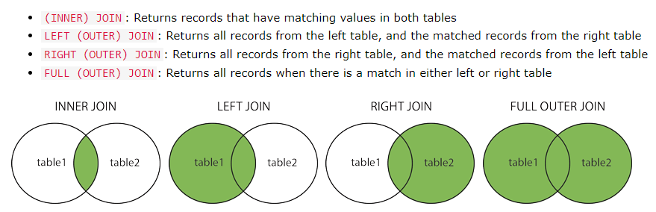
More Complex SQL Retrieval Queries
Joined Tables in SQL and Outer Joins

Slide 2
More Complex SQL Retrieval Queries
Joined Tables in SQL and Outer Joins
The default type of join in a joined table is called an inner join, where a tuple is included in the result only if a matching tuple exists in the other relation.
In SQL, the options available for specifying joined tables include:
INNER JOIN (only pairs of tuples that match the join condition are retrieved, same as JOIN),
LEFT OUTER JOIN (every tuple in the left table must appear in the result; if it does not have a matching tuple, it is padded with NULL values for the attributes of the right table),
RIGHT OUTER JOIN (every tuple in the right table must appear in the result; if it does not have a matching tuple, it is padded with NULL values for the attributes of the lefttable), and FULL OUTER JOIN. In the latter three options, the keyword OUTER may be omitted.
If the join attributes have the same name, one can also specify the natural join variation of outer joins by using the keyword NATURAL before the operation (for example, NATURAL LEFT OUTER JOIN).
The keyword CROSS JOIN is used to specify the CARTESIAN PRODUCT although this should be used only with the utmost care because it generates all possible tuple combinations.

Slide 3

More Complex SQL Retrieval Queries
Joined Tables in SQL and Outer Joins
The concept of a joined table (or joined relation) was incorporated into SQL to permit users to specify a table resulting from a join operation in the FROM clause of a query.
Join construct is easy to implement rather than mixing all statements in where clause
For example, consider query, which retrieves the name and address of every employee who works for the ‘Research’ department. It may be easier to specify the join of the EMPLOYEE and DEPARTMENT relations in the WHERE clause, and then to select the desired tuples and attributes.
The FROM clause in Q1A contains a single joined table. The attributes of such a table are all the attributes of the first table, EMPLOYEE, followed by all the attributes of the second table, DEPARTMENT.
The concept of a joined table also allows the user to specify different types of join, such as NATURAL JOIN and various types of OUTER JOIN. In a NATURAL JOIN on two relations R and S, no join condition is specified.

Slide 4
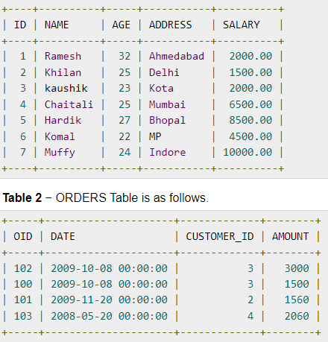
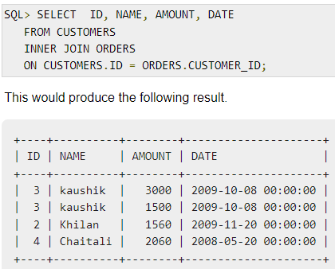
More Complex SQL Retrieval Queries
Joined Tables in SQL and Outer Joins – INNER JOIN
Notes:
Inner join return duplicates INTERSECT won’t return duplicates
INTERSECT show NULL values join won’t

Slide 5
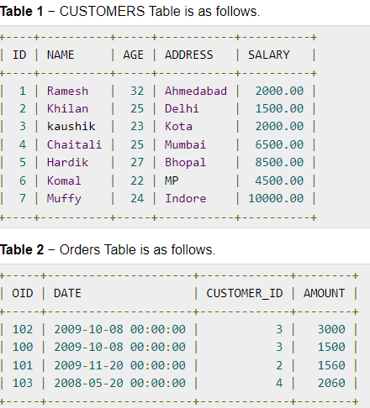
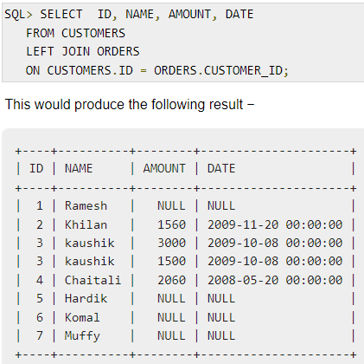
More Complex SQL Retrieval Queries
3 occurs two times because 3 is matched twice in the orders table as the customer has placed order two times.
Joined Tables in SQL and Outer Joins – LEFT JOIN

Slide 6
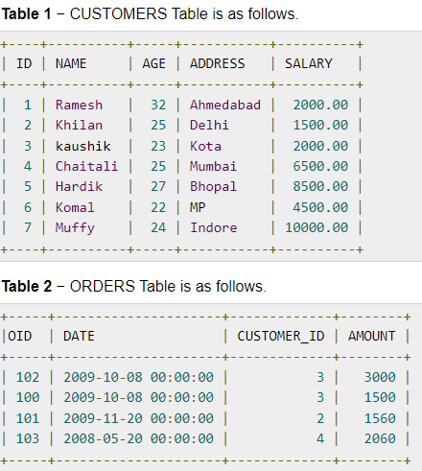
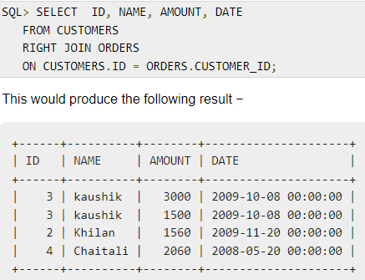
More Complex SQL Retrieval Queries
Joined Tables in SQL and Outer Joins – RIGHT JOIN

Slide 7
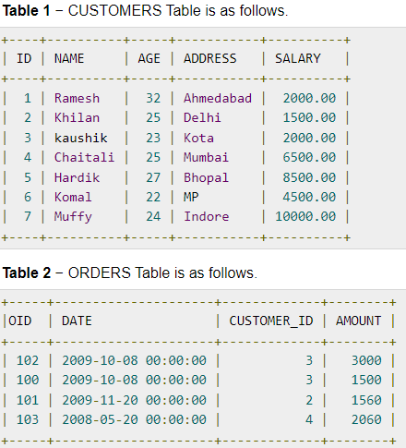
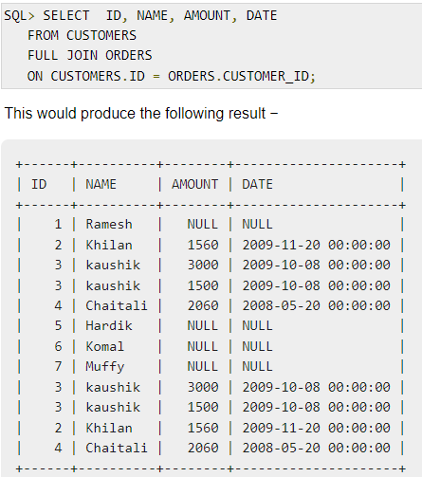
More Complex SQL Retrieval Queries
3 occurs two times because 3 is matched twice in the orders table as the customer has placed order two times.
Joined Tables in SQL and Outer Joins – FULL JOIN

Slide 8
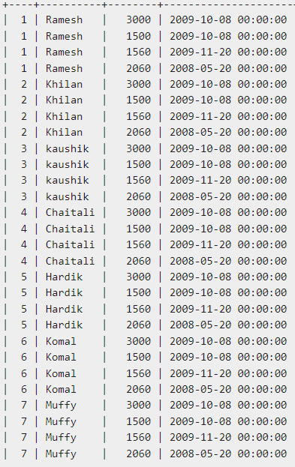

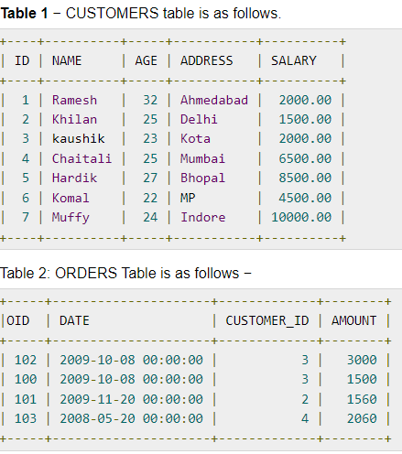
More Complex SQL Retrieval Queries
Joined Tables in SQL and Outer Joins – CROSS JOIN

Slide 9
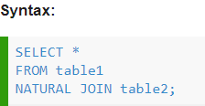
More Complex SQL Retrieval Queries
Joined Tables in SQL and Outer Joins – NATURAL JOIN
Natural Join joins two tables based on same attribute name and data types.
The resulting table will contain all the attributes of both the table but keep only one copy of each common column.
Don’t use ON clause

Slide 10
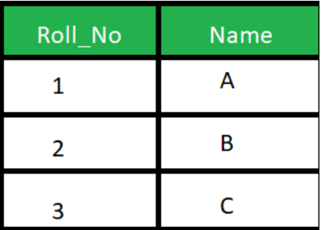
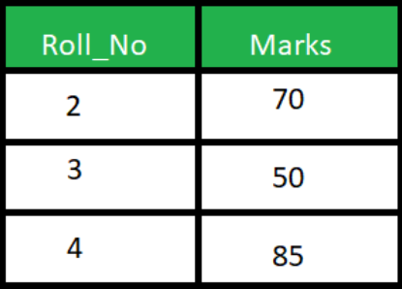

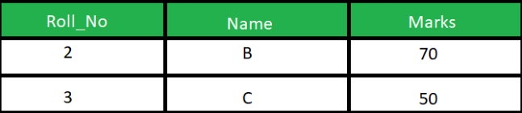
More Complex SQL Retrieval Queries
Joined Tables in SQL and Outer Joins – NATURAL JOIN
Student table
Marks table

Slide 11

More Complex SQL Retrieval Queries
Joined Tables in SQL and Outer Joins
It is also possible to nest join specifications; that is, one of the tables in a join may itself be a joined table.
This allows the specification of the join of three or more tables as a single joined table, which is called a multiway join.
For example, Q2A is a different way of specifying query Q2 from Section 6.3.1 using the concept of a joined table:

Slide 12

More Complex SQL Retrieval Queries
Aggregate Functions in SQL
Aggregate functions are used to summarize information from multiple tuples into a single-tuple summary.
Grouping is used to create subgroups of tuples before summarization.
A number of built-in aggregate functions exist: COUNT, SUM, MAX, MIN, and AVG.
The COUNT function returns the number of tuples or values as specified in a query.
The functions SUM, MAX, MIN, and AVG can be applied to a set or multiset of numeric values and return, respectively, the sum, maximum value, minimum value, and average (mean) of those values.

Slide 13

More Complex SQL Retrieval Queries
Aggregate Functions in SQL
We could use AS to rename the column names in the resulting single-row table; for example, as in Q19A.

Slide 14
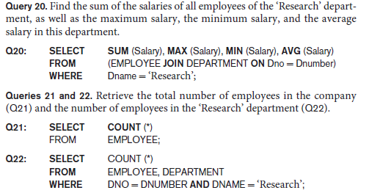
More Complex SQL Retrieval Queries
Here the asterisk (*) refers to the rows (tuples), so COUNT (*) returns the number of
rows in the result of the query. This includes NULL values and duplicates.
Aggregate Functions in SQL
If we want to get the preceding aggregate function values for employees of a specific department—say, the ‘Research’ department—we can write Query 20, where the EMPLOYEE tuples are restricted by the WHERE clause to those employees who work for the ‘Research’ department.

Slide 15

More Complex SQL Retrieval Queries
Aggregate Functions in SQL
We may also use the COUNT function to count values in a column rather than tuples.
COUNT(SALARY) – duplicate values won’t eliminate
COUNT(DISTINCT SALARY) - duplicate values eliminated.
However, any tuples with NULL for SALARY will not be counted.
COUNT(expression) does not count NULL values.

Slide 16
More Complex SQL Retrieval Queries
Aggregate Functions in SQL
MAX and MIN do not count NULL in their data evaluation. If we have a column containing only dates for instance and there is a NULL date, MAX and MIN will both ignore that value.
Aggregate functions such as SUM, COUNT, AVG, MAX, and MIN exclude NULL values.
In general, NULL values are discarded when aggregate functions are applied to a particular column (attribute); the only exception is for COUNT(*) because tuples instead of values are counted.
The general rule is as follows:
aggregate function is applied to a collection of values,
NULLs are removed from the collection before the calculation;
if the collection becomes empty because all values are NULL,
the aggregate function will return NULL (except in the case of COUNT, where it will return 0 for an empty collection of values).

Slide 17
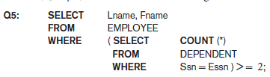
More Complex SQL Retrieval Queries
Aggregate Functions in SQL
We can specify a correlated nested query with an aggregate function, and then use the nested query in the WHERE clause of an outer query.
For example, to retrieve the names of all employees who have two or more dependents (Query 5), we can write the following:
The correlated nested query counts the number of dependents that each employee has; if this is greater than or equal to two, the employee tuple is selected.
SQL also has aggregate functions SOME and ALL that can be applied to a collection of Boolean values; SOME returns TRUE if at least one element in the collection is TRUE, whereas ALL returns TRUE if all elements in the collection are TRUE.

Slide 18
More Complex SQL Retrieval Queries
Grouping: The GROUP BY and HAVING Clauses
Sometimes we want to apply the aggregate functions to subgroups of tuples in a relation, where the subgrouping is done on some attribute values.
For example, we may want to find the average salary of employees in each department or the number of employees who work on each project.
In these cases, do following:
partition the relation into subsets (or groups) of tuples.
Each group will consist of the tuples that have the same value of some attribute(s), called the grouping attribute(s).
then apply the function to each such group independently
to produce summary information about each group.

Slide 19
More Complex SQL Retrieval Queries
Grouping: The GROUP BY and HAVING Clauses
The GROUP BY clause specifies the grouping attributes, which should also appear in the SELECT clause, so that the value resulting from applying each aggregate function to a group of tuples appears along with the value of the grouping attribute(s).
The GROUP BY statement is often used with aggregate functions (COUNT(), MAX(), MIN(), SUM(), AVG()) to group the result-set by one or more columns.
GROUP BY clause in the SELECT statement without using aggregate functions will behave like DISTINCT clause.

Slide 20
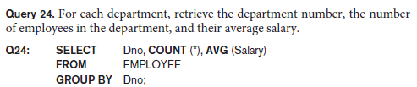
More Complex SQL Retrieval Queries
Grouping: The GROUP BY and HAVING Clauses
The SELECT clause includes only the grouping attribute and the aggregate functions to be applied on each group of tuples.

Slide 21
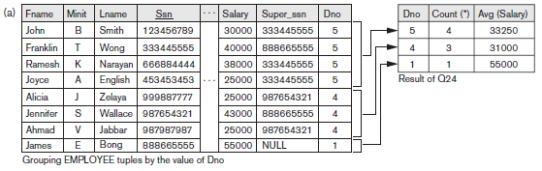
More Complex SQL Retrieval Queries
Grouping: The GROUP BY and HAVING Clauses

Slide 22
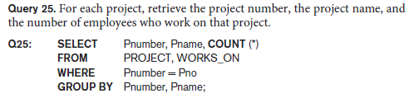
More Complex SQL Retrieval Queries
Grouping: The GROUP BY and HAVING Clauses
If NULLs exist in the grouping attribute, then a separate group is created for all tuples with a NULL value in the grouping attribute.
For example, if the EMPLOYEE table had some tuples that had NULL for the grouping attribute Dno, there would be a separate group for those tuples in the result of Q24.
Above query shows how we can use a join condition in conjunction with GROUP BY.
In this case, the grouping and functions are applied after the joining of the two relations in the WHERE clause.

Slide 23
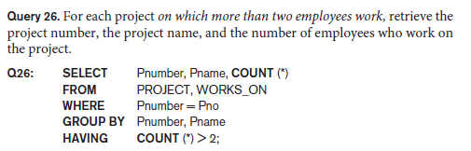
More Complex SQL Retrieval Queries
Grouping: The GROUP BY and HAVING Clauses
SQL provides a HAVING clause, which can appear in conjunction with a GROUP BY clause.
HAVING provides a condition on each value of the grouping attributes.
The HAVING clause was added to SQL because the WHERE keyword cannot be used with aggregate functions.
Only the groups that satisfy the condition are retrieved in the result of the query. This is illustrated by Query 26.

Slide 24
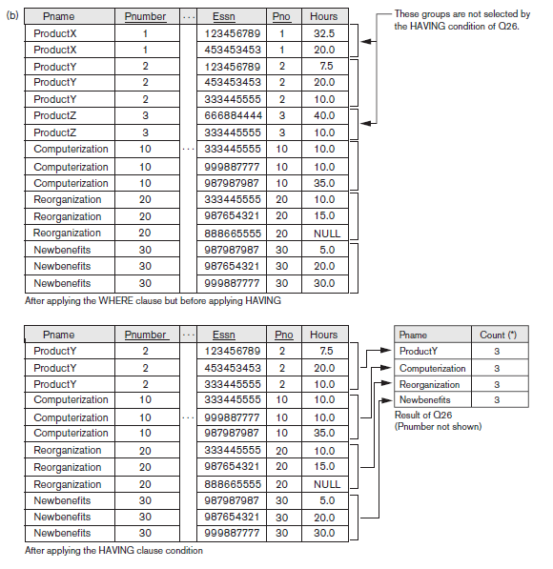
More Complex SQL Retrieval Queries

